Slide 1

WM275: Machine Intelligence
Day 3: Informed Search

Slide 2
Recap
Introduction to Machine intelligence
Intelligent Agents
Search:
Uninformed Search, Uninformed Search
Informed search and exploration
Adversarial Search
Constraint satisfaction problems
Knowledge and reasoning:
Logic, propositional logic, Inference using logic, Intro to first order logic

Slide 3
Recap
Search: Formulating a search problem
Uninformed Search: Search strategies have no additional information about states beyond that provided in the problem definition
Breadth first search: FIFO
Depth first search: LIFO
Iterative deepening search
Uniform cost search
Bidirectional search

Slide 4
Outline
Informed search
Greedy best first search
Heuristic functions
A* search
Optimality, heuristic properties
Creating and combining heuristics

Slide 5
What is Search?
It is the process of looking for a sequence of actions that reaches the goal

Slide 6
informed/heuristic search
Credits: Many animations in this PPT have been adapted from [2]

Slide 7

Informed/heuristic search
Strategies that know whether one non-goal state is “more promising” than another.
What actually happens in a UCS

Slide 8
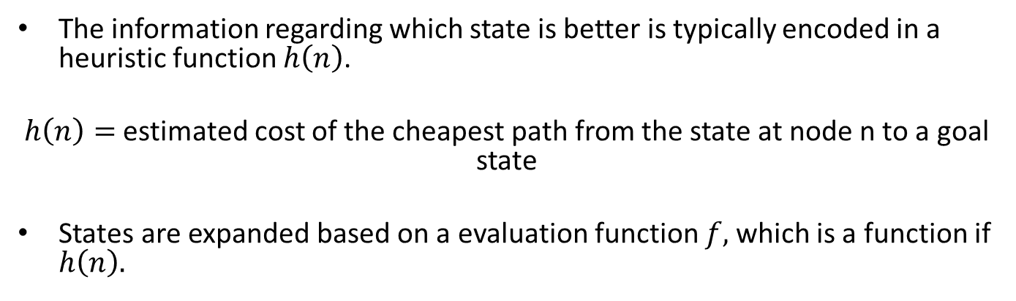
Heuristic function
The information regarding which state is better is typically encoded in a heuristic function $h\left(n\right)$.
$h\left(n\right)=$ estimated cost of the cheapest path from the state at node n to a goal state
States are expanded based on a evaluation function $f,$which is a function if $h\left(n\right).$
Remember? UCS used $g(n)$, the actual cost to reach node $n$ from root node.

Slide 9
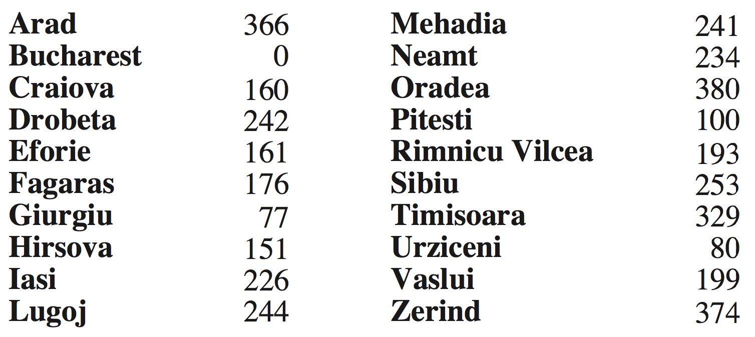
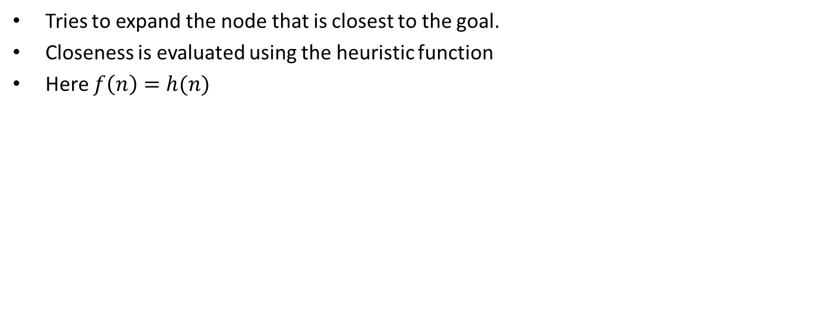
Greedy best first search
Tries to expand the node that is closest to the goal.
Closeness is evaluated using the heuristic function
Here $f\left(n\right)=h(n)$
What is the path chosen by GBFS?
What happens now?
h_{SLD}(n) = straight-line distance to Bucharest
Notes:
Isai to Fagaras --- note h(n) will be different as this is a different problem

Slide 10
A* Search
Notes:
Pronounced A Star

Slide 11
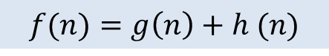
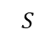
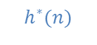
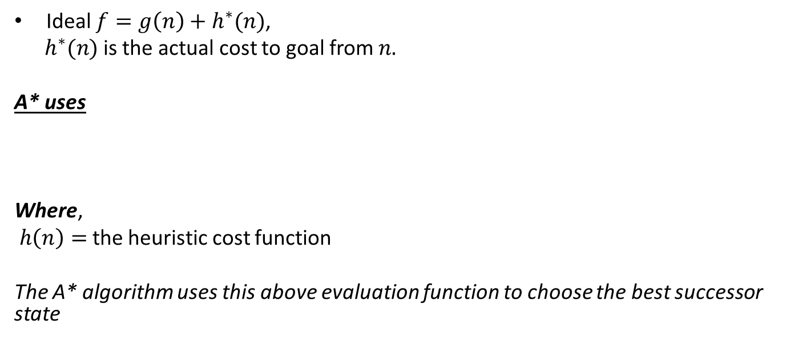
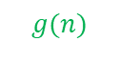
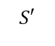
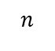
A* evaluation function
Ideal $f=g\left(n\right)+h^{∗}(n)$,
$h^{∗}(n)$ is the actual cost to goal from $n.$
A* uses
Where,
$h\left(n\right)=$ the heuristic cost function
The A* algorithm uses this above evaluation function to choose the best successor state
Past cost
Future cost
$$g(n)$$
$$h^{∗}(n)$$
$$S$$
$$n$$
$$S′$$
$$f(n)=g\left(n\right)+h (n)$$

Slide 12
Will any heuristic work?
What path does A* choose for this problem?
Heuristic needs to have two properties to guarantee optimality of A*
Admissibility
Consistency
h = 6
2
1
A
S
G
h = 0
h = 8
6
Notes:
Tree search needs only admissibility

Slide 13
Admissible Heuristics
A heuristic h is admissible (optimistic):
0 ≤ h(n) ≤ h*(n)
If h is admissible, we can prove that A* tree search is optimal.

Slide 14
Optimality of A* Tree Search
Assume:
A is an optimal goal node
B is a suboptimal goal node
h is admissible
Claim:
A will be chosen for expansion before B
…
A
B

Slide 15
Optimality of A* Tree Search: Blocking
Proof:
Imagine B is on the frontier
Some ancestor n of A is on the frontier, too (maybe A itself!)
Claim: n will be expanded before B
f(n) is less than or equal to f(A)
…
n
A
B
f(n) = g(n) + h(n) Definition of f-cost
≤ g(n) + h*(n) Admissibility of h, h*(n)=true cost to goal
≤ g(A)
g(A) = f(A) h = 0 at a goal
Source [2]

Slide 16
Optimality of A* Tree Search: Blocking
Proof:
Imagine B is on the frontier
Some ancestor n of A is on the frontier, too (maybe A itself!)
Claim: n will be expanded before B
f(n) is less than or equal to f(A)
f(A) is less than f(B)
…
n
A
B
g(A) < g(B) Suboptimality of B
f(A) < f(B) h = 0 at a goal
Source [2]

Slide 17
Optimality of A* Tree Search: Blocking
Proof:
Imagine B is on the frontier
Some ancestor n of A is on the frontier, too (maybe A itself!)
Claim: n will be expanded before B
f(n) is less than or equal to f(A)
f(A) is less than f(B)
n is expanded before B
All ancestors of A are expanded before B
A is expanded before B
A* tree search is optimal
…
n
A
B
f(n) ≤ f(A) < f(B)
Source [2]

Slide 18
Is admissibility good enough?
Consider is A* graph search problem
Search tree
h=4
A
S (0+2)
1
h=1
S
1
C
A (1+4)
B (1+1)
h=2
1
2
B
3
C (2+1)
C (3+1)
h=1
G
G (5+0)
G (6+0)
State space graph
Fancy check allows new C if cheaper than old but requires recalculating C’s descendants
Simple check against expanded set blocks C
h=0
Source [2]

Slide 19
Consistency of Heuristics
Main idea: estimated heuristic costs ≤ actual costs
Admissibility: heuristic cost ≤ actual cost to goal
h(A) ≤ h*(A)
Consistency: heuristic “arc” cost ≤ actual cost for each arc
h(A) – h(C) ≤ c(A,C)
or h(A) ≤ c(A,C) + h(C) (triangle inequality)
Consequences of consistency:
1. The f value along a path never decreases:
h(A) ≤ c(A,C) + h(C)
=> g(A) + h(A) ≤ g(A) + c(A,C) + h(C)
f(A) ≤ f(C)
2. A* graph search is optimal
A
1
C
h=4
h=1
h=3
3
G
Source [2]

Slide 20
Optimality of A* Graph Search
Sketch: consider what A* does with a consistent heuristic:
Fact 1: In tree search, A* expands nodes in increasing total f value (f-contours)
Fact 2: For every state s, nodes that reach s optimally are expanded before nodes that reach s suboptimally
Result: A* graph search is optimal
…
f ≤ 1
f ≤ 2
f ≤ 3
Source [2]

Slide 21
Creating Heuristics

Slide 22
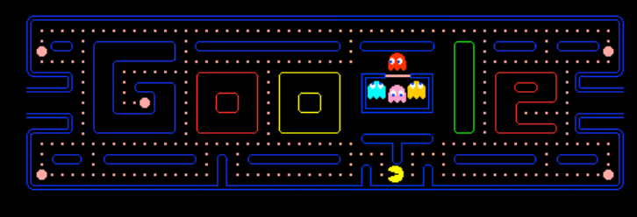
Creating Admissible Heuristics
Often, admissible heuristics are solutions to relaxed problems, where new actions are available
Notes:
RE

Slide 23
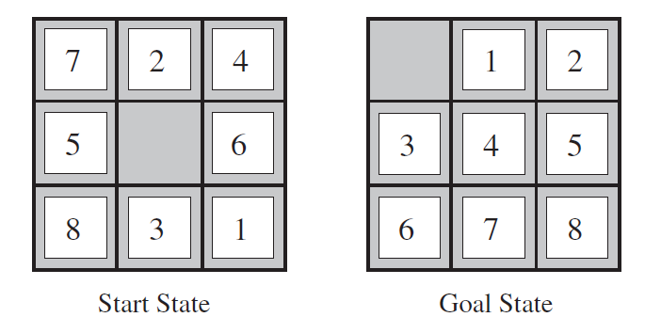
Example: 8 Puzzle
What are the states?
How many states?
What are the actions?
What are the step costs?
Notes:
9! = 362,880 but 16! (15-puzzle) = 20 trillion, 25! = 10^25

Slide 24
8 Puzzle Heuristic 1
Heuristic: Number of tiles misplaced
Why is it admissible?
h(start) =
8
 | Average nodes expanded when the optimal path has…
 | …4 steps | …8 steps | …12 steps
UCS | 112 | 6,300 | 3.6 x 10⁶
A*TILES | 13 | 39 | 227
Source [2]
Statistics from Andrew Moore

Slide 25
8 Puzzle Heuristic 2
What if we had an easier 8-puzzle where any tile could slide any direction at any time, ignoring other tiles?
Total Manhattan distance
Why is it admissible?
h(start) =
 | Average nodes expanded when the optimal path has…
 | …4 steps | …8 steps | …12 steps
A*TILES | 13 | 39 | 227
A*MANHATTAN | 12 | 25 | 73
3 + 1 + 2 + … = 18

Slide 26
Combining heuristics
Dominance: h₁ ≥ h₂ if
∀n h₁(n) ≥ h₂(n)
Roughly speaking, larger is better as long as both are admissible
The zero heuristic is pretty bad (what does A* do with h=0?)
The exact heuristic is pretty good, but usually too expensive!
What if we have two heuristics, neither dominates the other?
Form a new heuristic by taking the max of both:
h(n) = max( h₁(n), h₂(n))
Max of admissible heuristics is admissible and dominates both!
Notes:
Semi-lattice: x <= y <-> x = x ^ y

Slide 27
Bibliography and References
Artificial Intelligence: Pearson New International Edition: A Modern Approach, Pearson Education UK, 2013.
CS188, Introduction to Artificial Intelligence. https://inst.eecs.berkeley.edu/~cs188
Tatsunori Hashimoto, Jiajun Wu, CS221: Artificial Intelligence: Principles and Technique. https://stanford-cs221.github.io/winter2021/
Chris Piech, Artificial Intelligence: Principles and Techniques. https://stanford.edu/~cpiech/cs221/index.html
Amy Greenwald, Enrique Areyan, CSC1410: Artificial Intelligence. http://cs.brown.edu/courses/cs141/
Poole, David L., and Alan K. Mackworth. Artificial Intelligence: foundations of computational agents. 2nd Edition. Cambridge University Press, 2017.

